Slide 1
God is Calling You to His Purposes 上帝在呼召你成就祂的旨意
Joshua 約書亞記 5:2-12

Slide 2
Joshua 5:2-8 2 At that time the Lord said to Joshua, “Make flint knives and circumcise the Israelites again.” 3 So Joshua made flint knives and circumcised the Israelites at Gibeath Haaraloth. 4 Now this is why he did so: All those who came out of Egypt—all the men of military age—died in the wilderness on the way after leaving Egypt. 5 All the people that came out had been circumcised, but all the people born in the wilderness during the journey from Egypt had not.
約書亞記 5:2-8
2 那時，耶和華吩咐約書亞說：「你製造火石刀，第二次給以色列人行割禮。」
3 約書亞就製造了火石刀，在亞拉錄山給以色列人行割禮。
4 約書亞行割禮的緣故，是因為從埃及出來的眾民，無論是男丁，都是能打仗的人，出了埃及以後，都死在曠野的路上。
5 因為出埃及的眾民都受過割禮；但在曠野的路上，出埃及以後所生的眾民都沒有受過割禮。

Slide 3
6 The Israelites had moved about in the wilderness forty years until all the men who were of military age when they left Egypt had died, since they had not obeyed the Lord. For the Lord had sworn to them that they would not see the land he had solemnly promised their ancestors to give us, a land flowing with milk and honey. 7 So he raised up their sons in their place, and these were the ones Joshua circumcised. They were still uncircumcised because they had not been circumcised on the way. 8 And after the whole nation had been circumcised, they remained where they were in camp until they were healed.
6 以色列人在曠野走了四十年，等到國內的民，就是出埃及的兵丁都消滅了，因為他們沒有聽從耶和華的話。耶和華曾向他們起誓，必不容他們看見耶和華向他們列祖起誓應許給我們的地，就是流奶與蜜之地。
7 他們的子孫，就是耶和華所興起來接續他們的，約書亞都給他們行了割禮，因為他們沒有受過割禮，約書亞給他們行了這禮。
8 國民都受完了割禮，就住在營中自己的地方，等到痊癒了

Slide 4
When God is calling you into His Purposes
God wants You to Pause and Trust Him.
當上帝呼召你進入祂的旨意:
祂希望你停下腳步，信靠祂

Slide 5
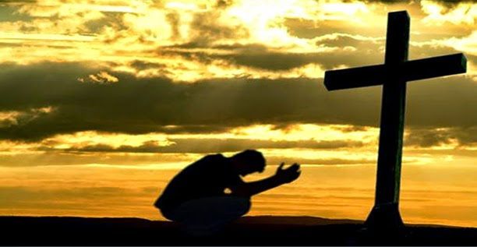
When God is calling you into His Purposes
God wants You to Renew Your Love Relationship with Him.
Renew Your Covenant Commitment.
當上帝呼召你進入祂的旨意時，祂希望你:
更新與祂之間愛的關係
更新你與祂所立的約

Slide 6
Joshua 5:9
Then the Lord said to Joshua, “Today I have rolled away the reproach of Egypt from you.” So the place has been called Gilgal to this day.
When God is calling you into His Purposes
God wants to Roll Away the Past that Hinders You.
約書亞記 5:9
耶和華對約書亞說：「我今日已經滅除了埃及的羞辱，這地方因此名叫吉甲，直到今日。」
當上帝呼召你進入祂的旨意時:
祂要除去阻挡你的過去

Slide 7
Joshua 5:10-12 10 On the evening of the fourteenth day of the month, while camped at Gilgal on the plains of Jericho, the Israelites celebrated the Passover. 11 The day after the Passover, that very day, they ate some of the produce of the land: unleavened bread and roasted grain. 12 The manna stopped the day after they ate this food from the land; there was no longer any manna for the Israelites, but that year they ate the produce of Canaan.
When God is calling you into His Purposes
God Wants You to Stop Having a Wilderness Mentality
約書亞記 5:2-12
10 以色列人在吉甲安營；正月十四日晚上，在耶利哥的平原守逾越節。
11 逾越節的次日，他們就吃了那地的出產：正當那日，吃無酵餅和烘的穀。
12 他們吃了那地的出產，第二日，嗎哪就止住了；以色列人也不再有嗎哪了，那一年他們卻吃迦南地的出產。
當上帝呼召你進入祂的旨意時
祂希望你停止在曠野時的心態

Slide 8
Zach Williams & Dolly Parton “There was Jesus.”
https://youtu.be/AEmq1V3UqVg?si=lpga2n1pIS5XgM-e
扎克·威廉斯，多莉·帕頓
《那裡有耶穌》

Slide 9
Review –
When God is calling you into His Purposes
God wants You to Pause and Trust Him.
God wants You to Renew Your Love Relationship with Him. - Renew Your Covenant Commitment.
God wants to Roll Away the Past that Hinders You.
God Wants You to Stop Having a Wilderness Mentality
總結
當上帝呼召你進入祂的旨意時:
祂希望你停下腳步並信靠祂
祂希望你更新與祂之間愛的關係 – 更新你與祂所立的約
祂要除去阻挡你的過去
祂希望你停止在曠野時的心態

